Slide 1
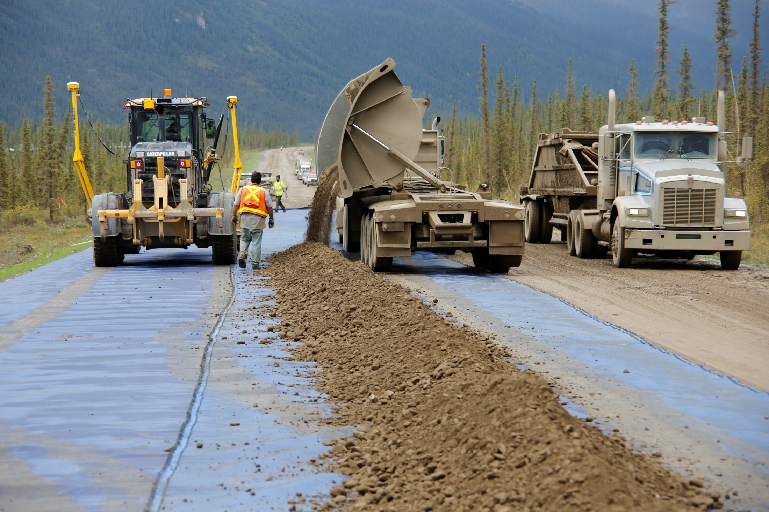
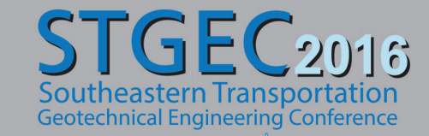
Mitigating Drainage and Moisture Failures in Foundation Systems
Presenter: Nathalia Castro, MSC

Slide 2
Geotextile Functions
Separation
Confinement
Reinforcement
Filtration
Drainage

Slide 3
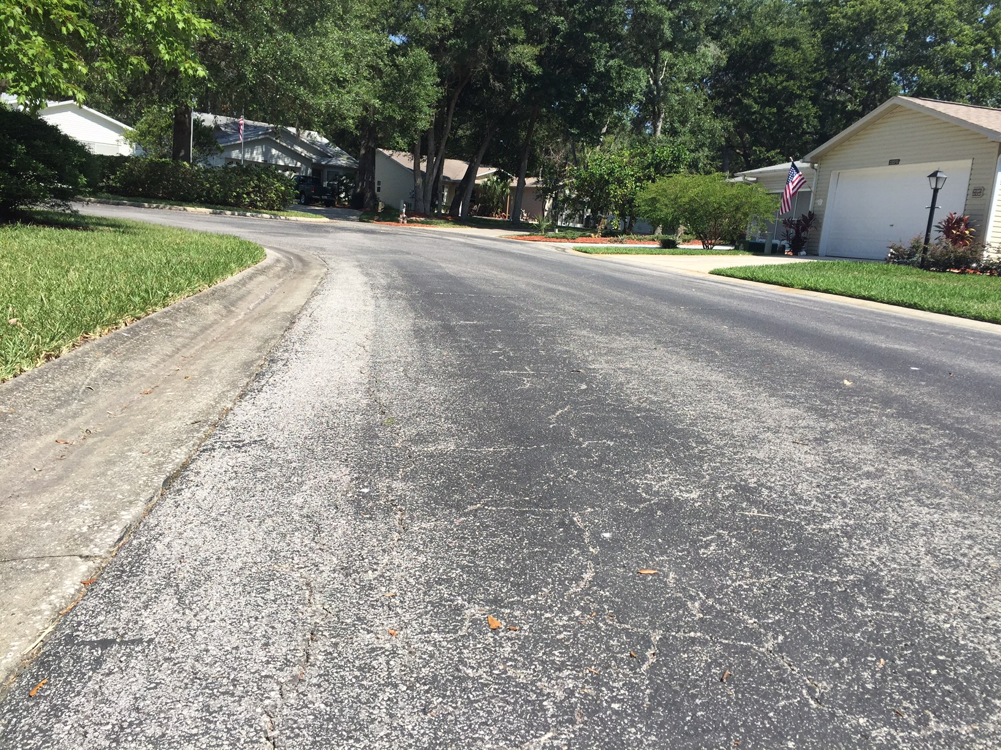
Drainage: Why is it important?
Notes:
Designers use to state that The 3 most important aspects of good road design are drainage, drainage & drainage
These photos show examples of poor drainage systems

Slide 4
Drainage: Why is it important?
No other single feature is as important in determining the ability of a pavement to withstand the effects of weather and traffic
Accumulation of water in the base or subbase may cause distress regardless of the structural section used
Water trapped in any element of the pavement structure reduces the internal friction and lowers the shear strength of the material
It may cause cracking or disintegration of the pavement or pumping of fine grained soil into the base

Slide 5
Drainage Mitigation options
Nonwoven Geotextiles
Drainage Geocomposites
Geonets
Wicking Geotextile

Slide 6
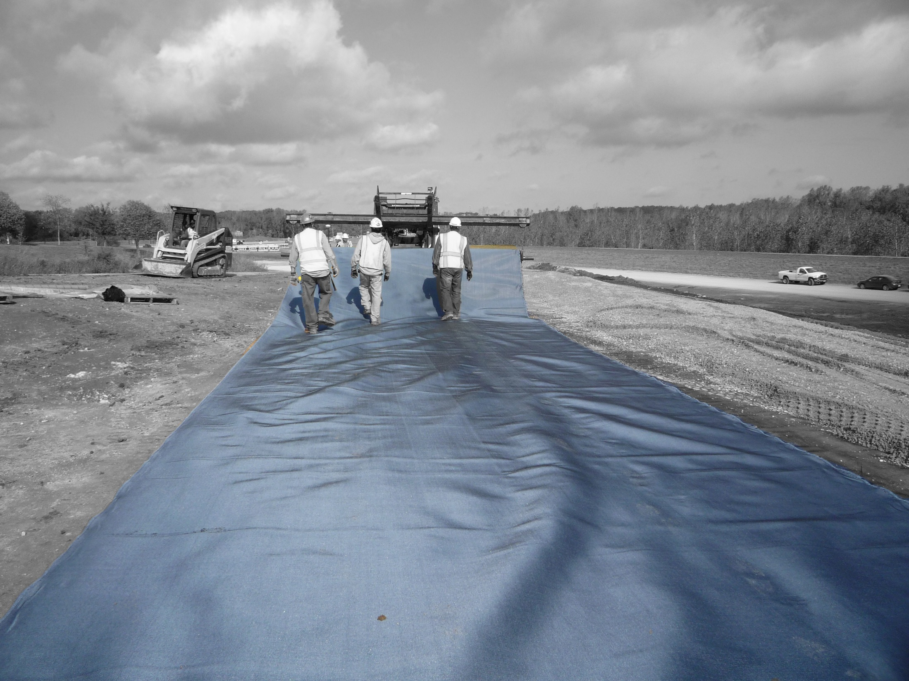
Enhanced Lateral Drainage System

Slide 7
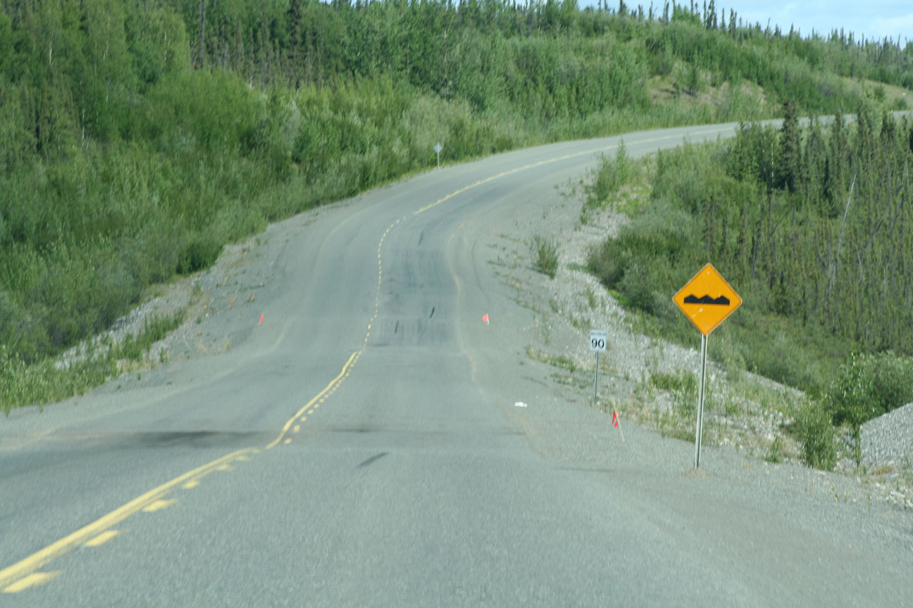

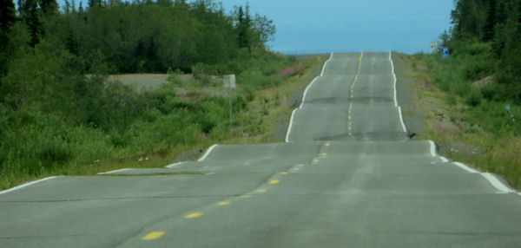

Slide 8
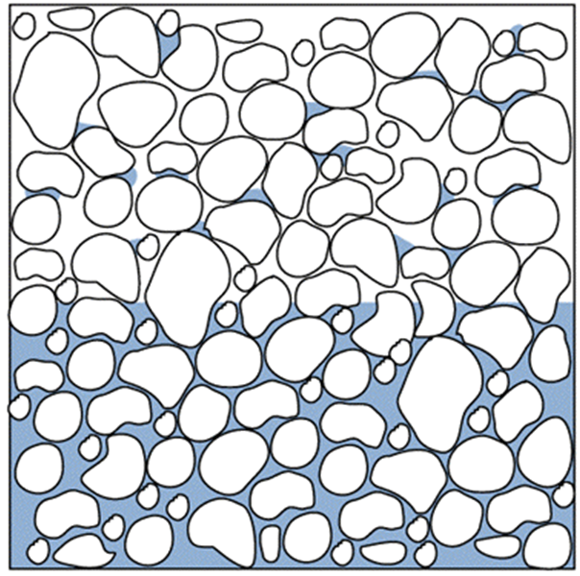
Frost-Heave
Frost susceptible
Temperature below freezing
Water
  Ground water
  Infiltration
  Aquifer
  Held within fines

Slide 9
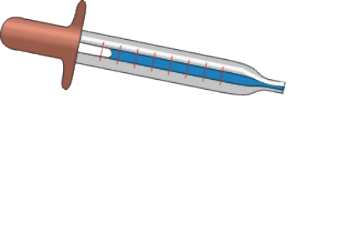

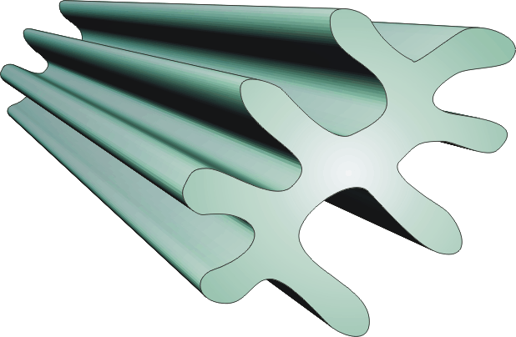
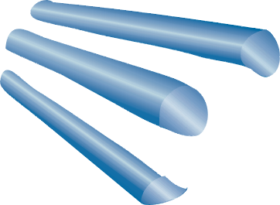
Engineered Yarn Cross Section

Slide 10
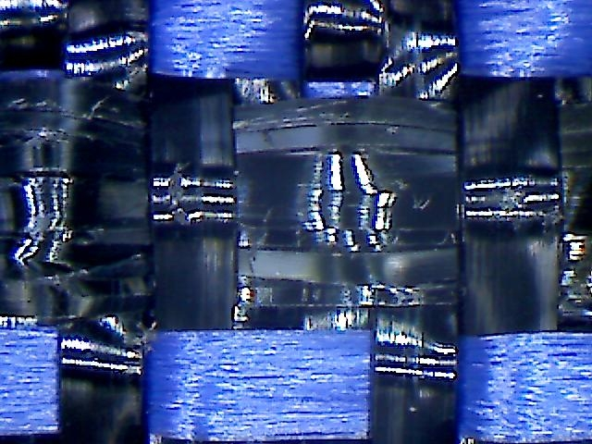
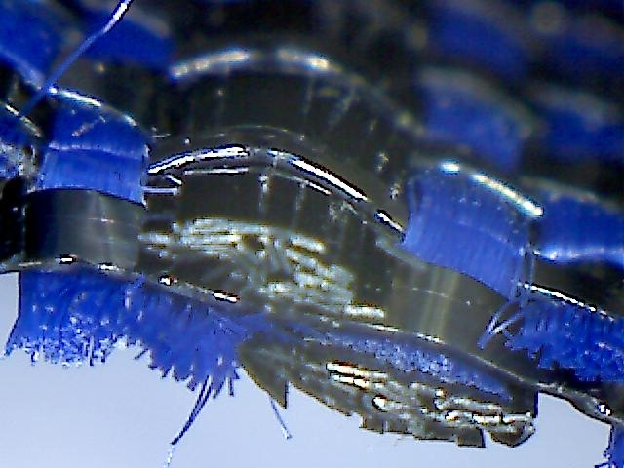
High Strength Wicking Geotextile

Slide 11
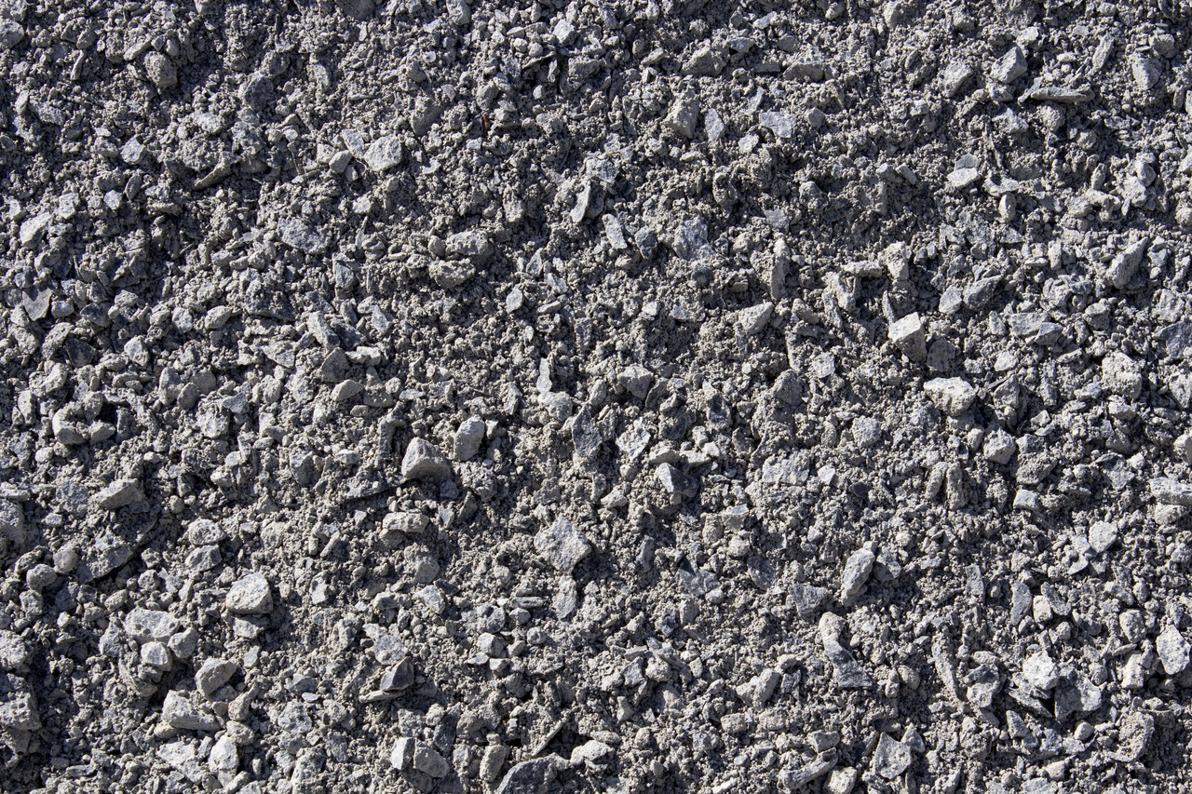
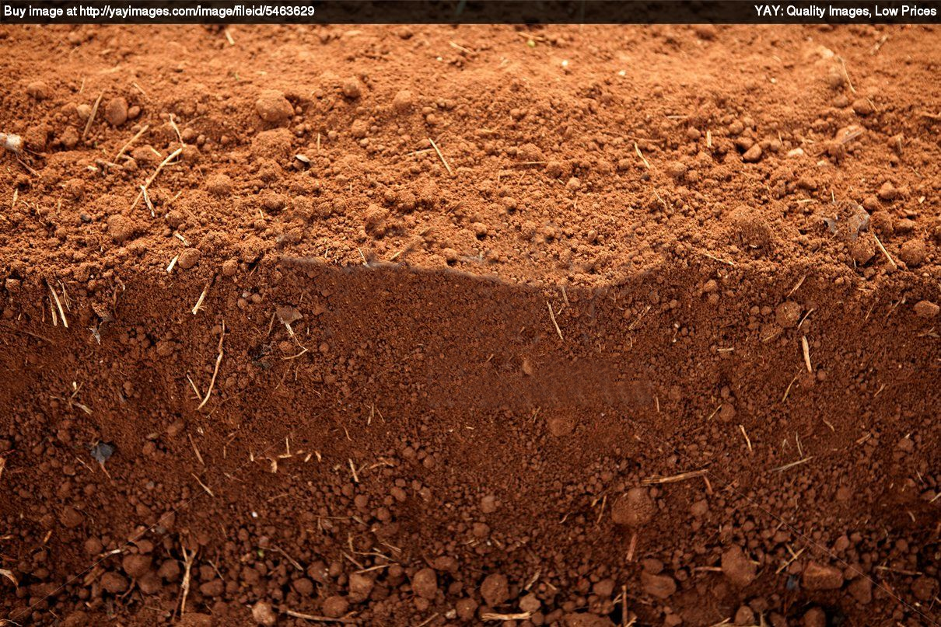
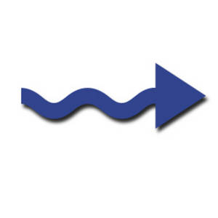

Slide 12
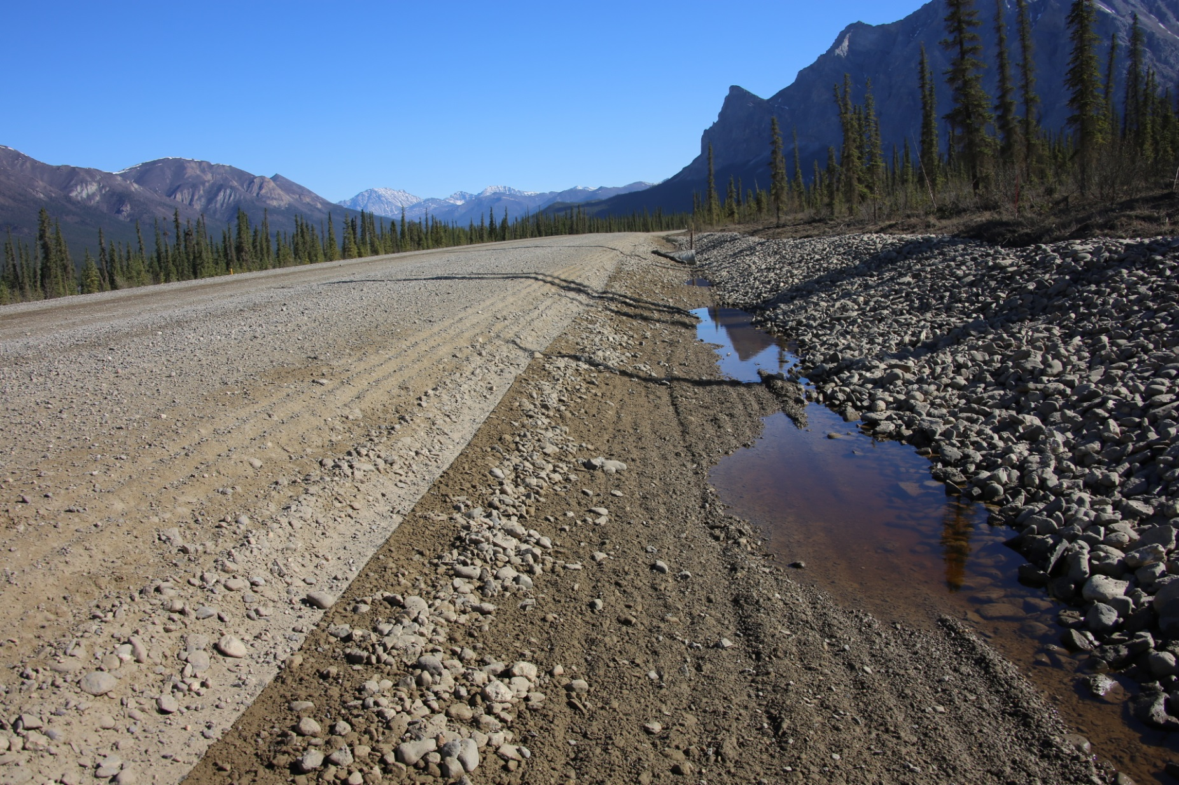
Applications: Frost-Heave
Notes:
Dalton Highway with Mirafi® H₂Ri, June 2013 – 3 years after being installed

Slide 13
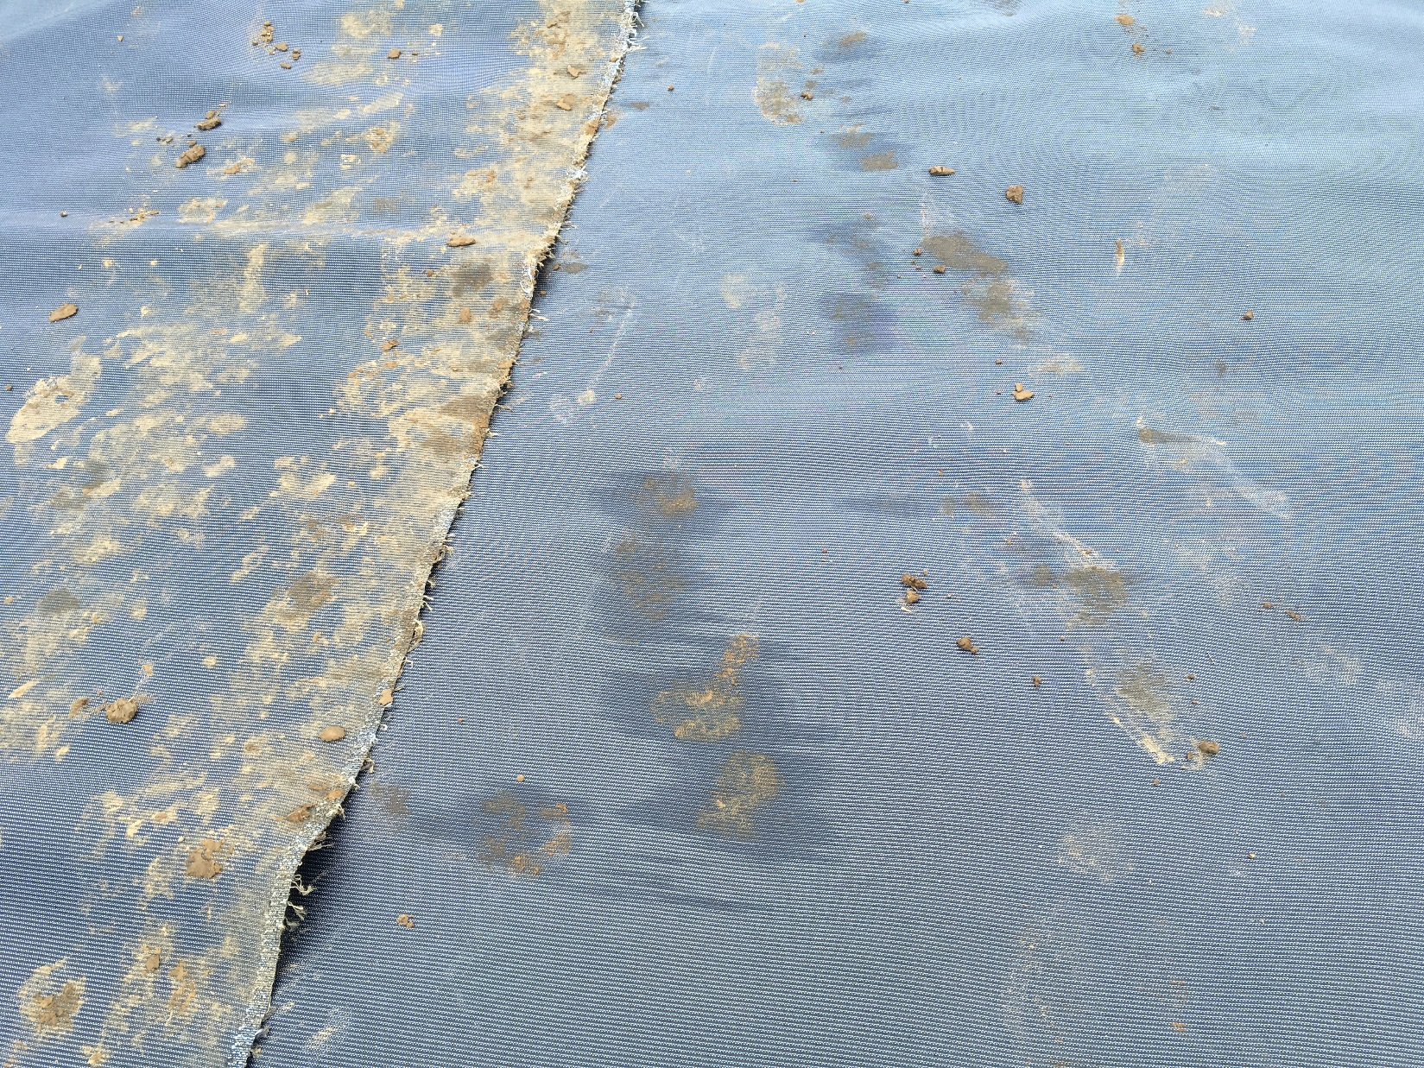

Slide 14
Applications: High Water Table Foundations
The geosynthetic will function as a drain and or a capillary barrier

Slide 15
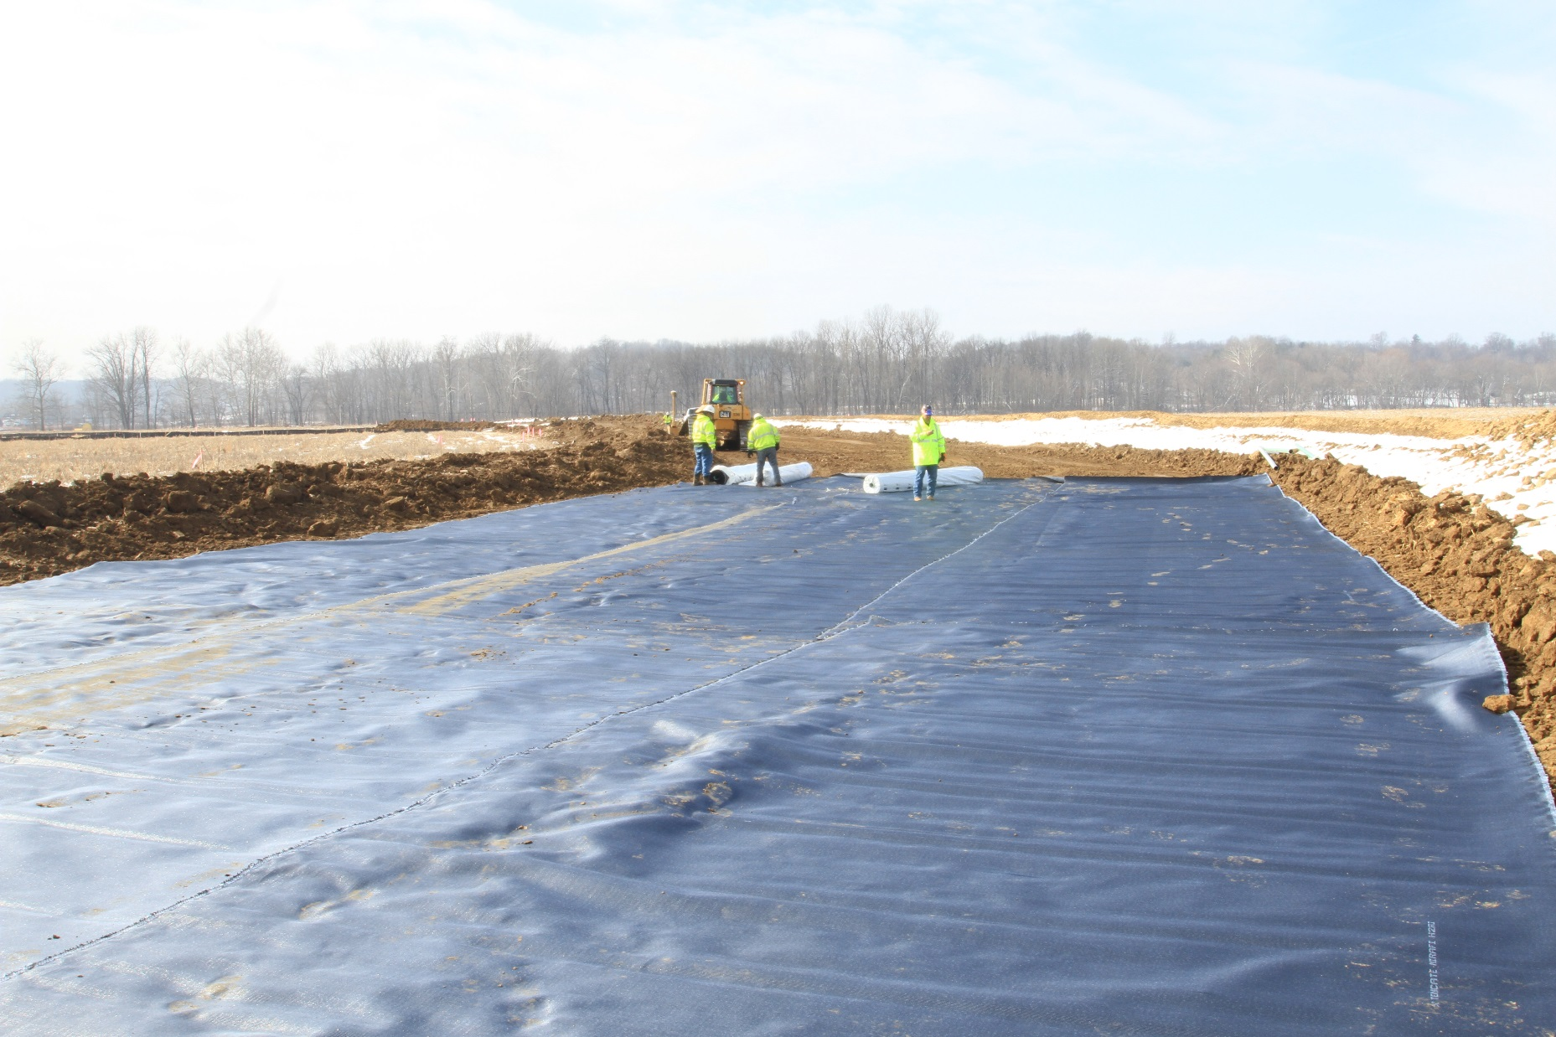
Applications: High Water Table
Notes:
INDIANA DOT (INDOT) I-69 P3 PROJECT: Liberty Church Interchange

Slide 16
Applications: Expansive Subgrades

Slide 17
Applications: Expansive Subgrades
Notes:
SH21 (State Highway) – Texas, USA – TXDOT state highway improvement plan
A stretch of approximately 6 miles

Slide 18
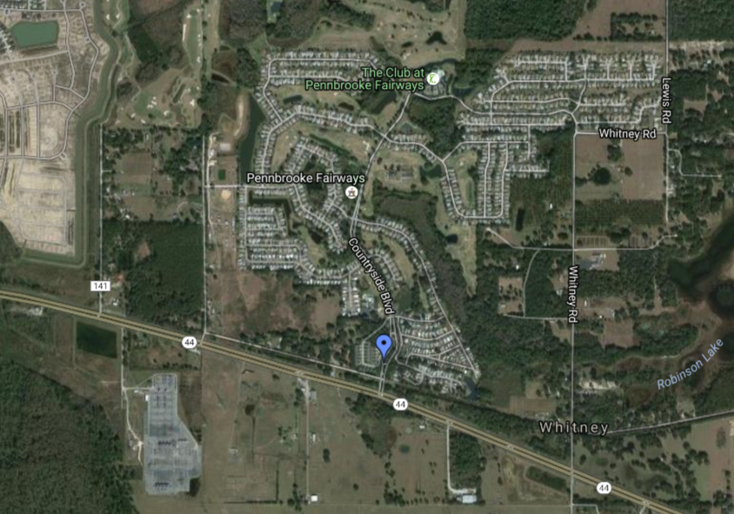
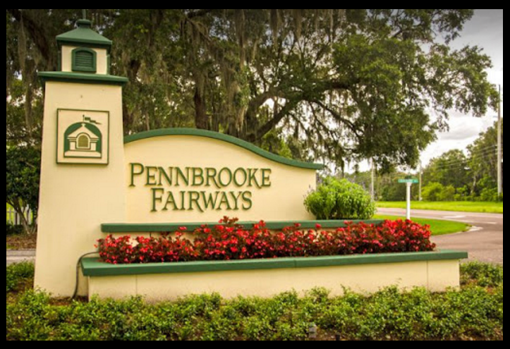
Pennbrooke Fairways Project

Slide 19
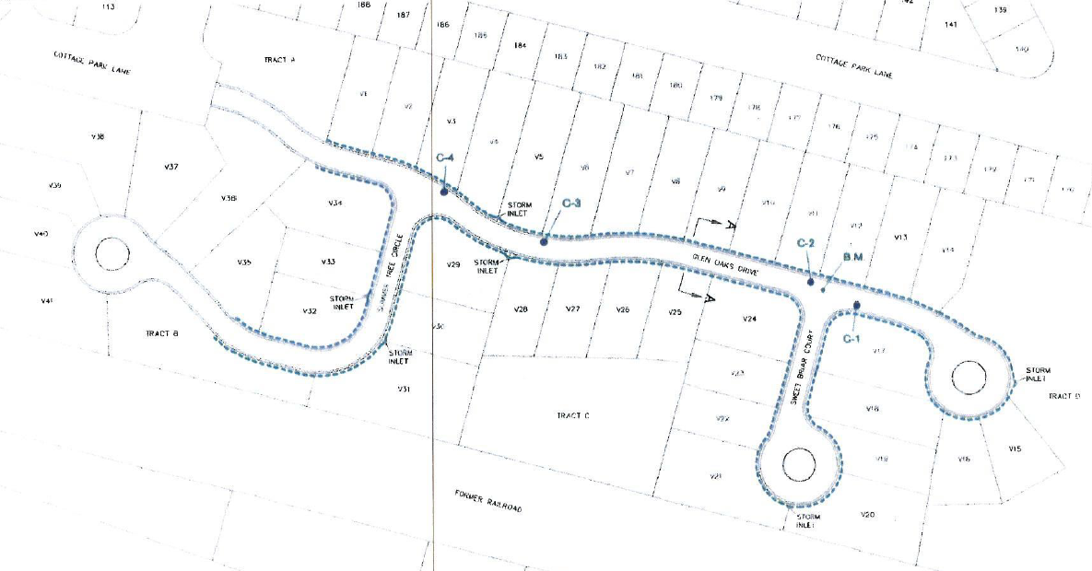
Pennbrooke Fairways Project

Slide 20
Pennbrooke Fairways Project

Slide 21
Pennbrooke Fairways Project
Based upon the findings:
Stabilized groundwater table – between 27 to 51 inches
Shallow deposits of silty and clayey soils immediately beneath the base course
Transient perched groundwater during rainy season - unsaturated condition
Bubbling groundwater caused by excess groundwater pressure
Excess groundwater pressure - relieved through cracks in the asphalt surface

Slide 22
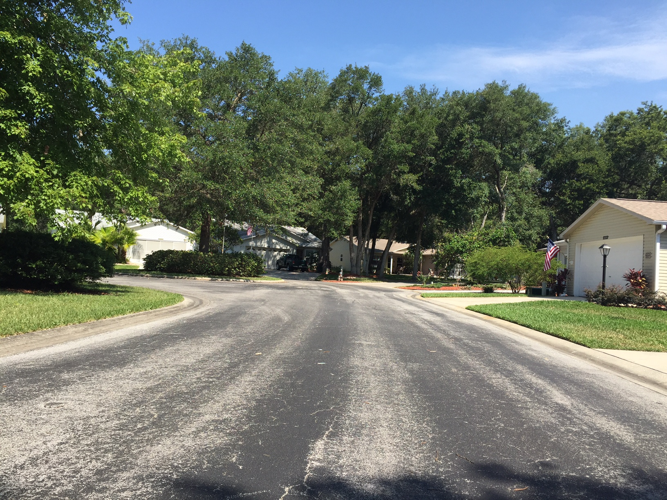
Pennbrooke Fairways Project

Slide 23
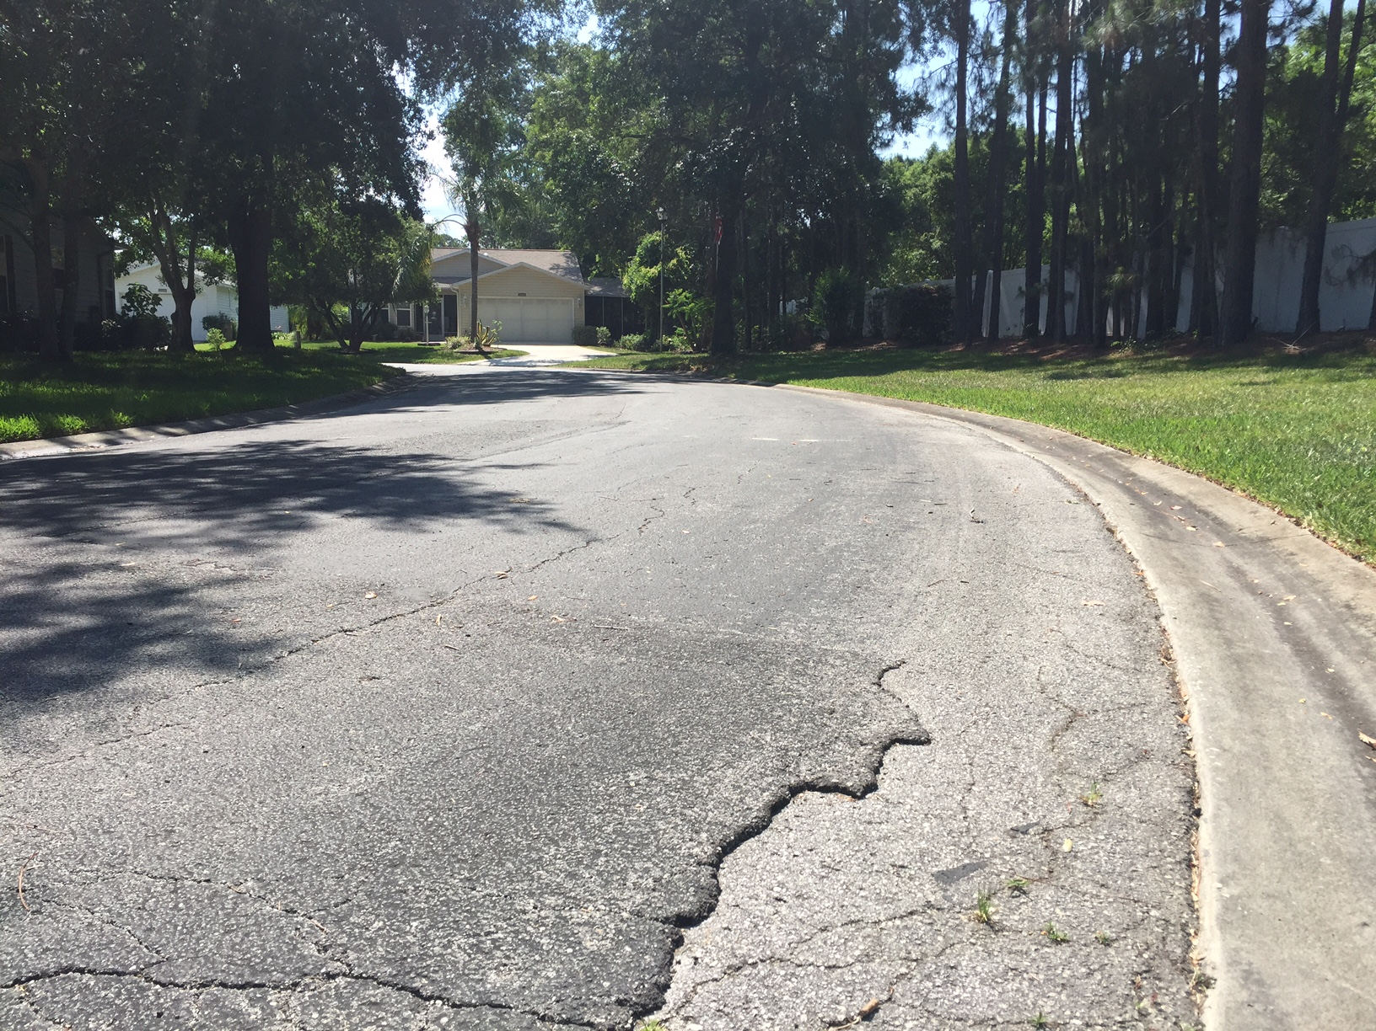
Pennbrooke Fairways Project

Slide 24
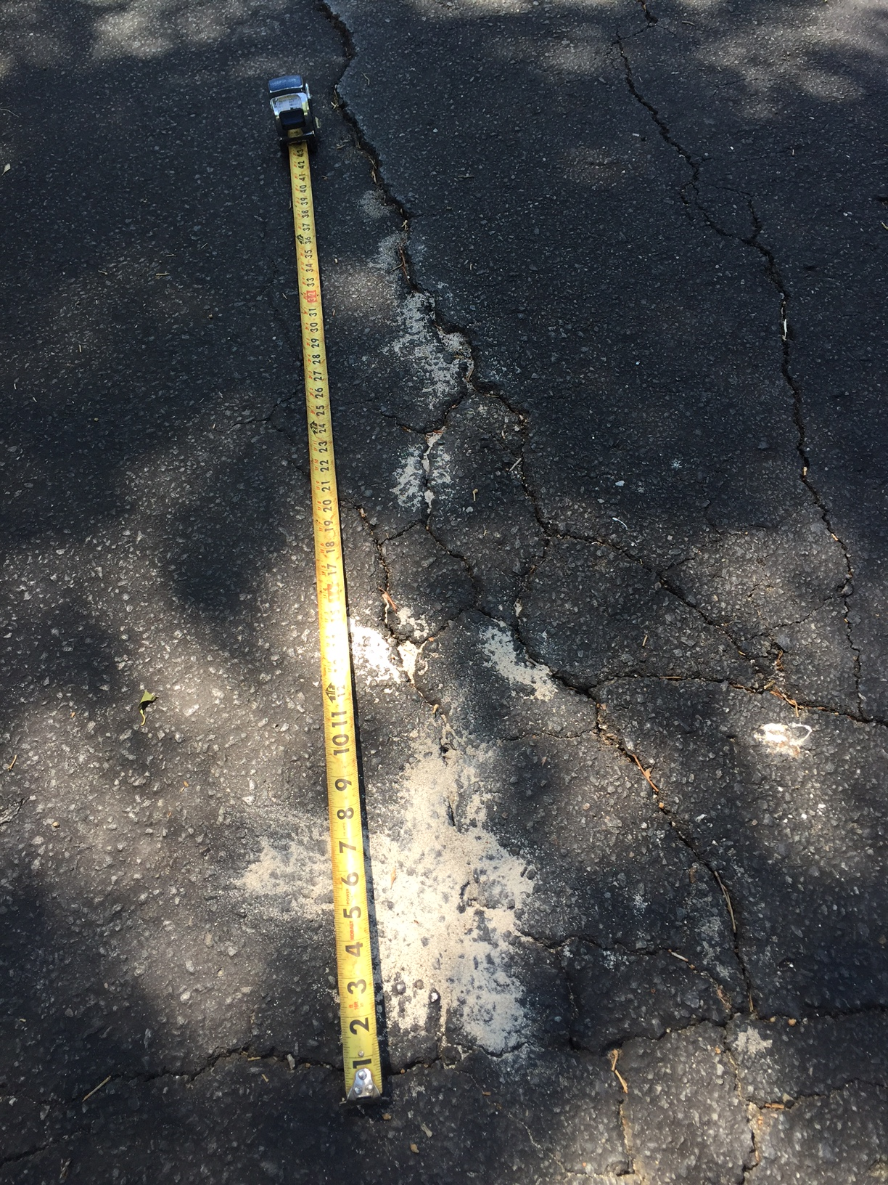
Pennbrooke Fairways Project

Slide 25
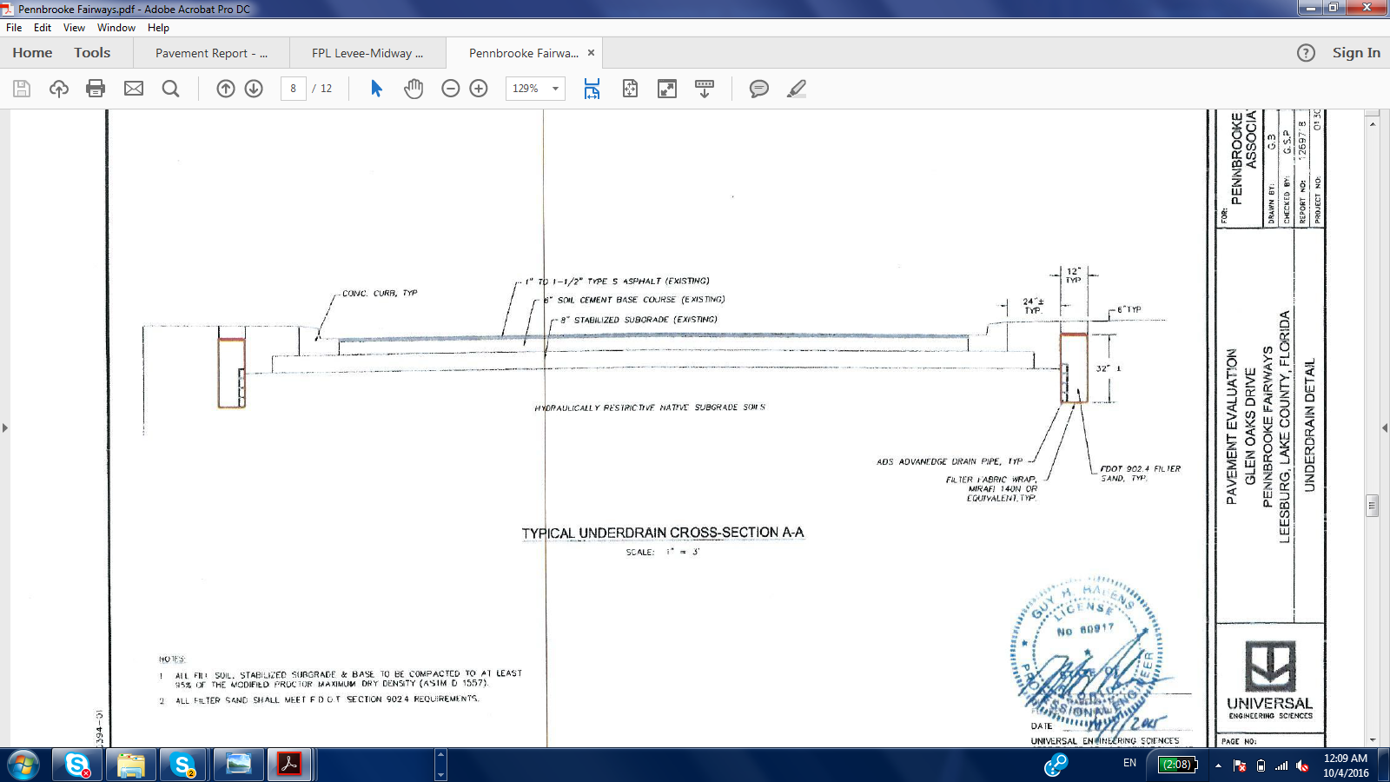
Pennbrooke Fairways Project

Slide 26
Pennbrooke Fairways Project
~15” of undercut without reinforcement and separation

Slide 27
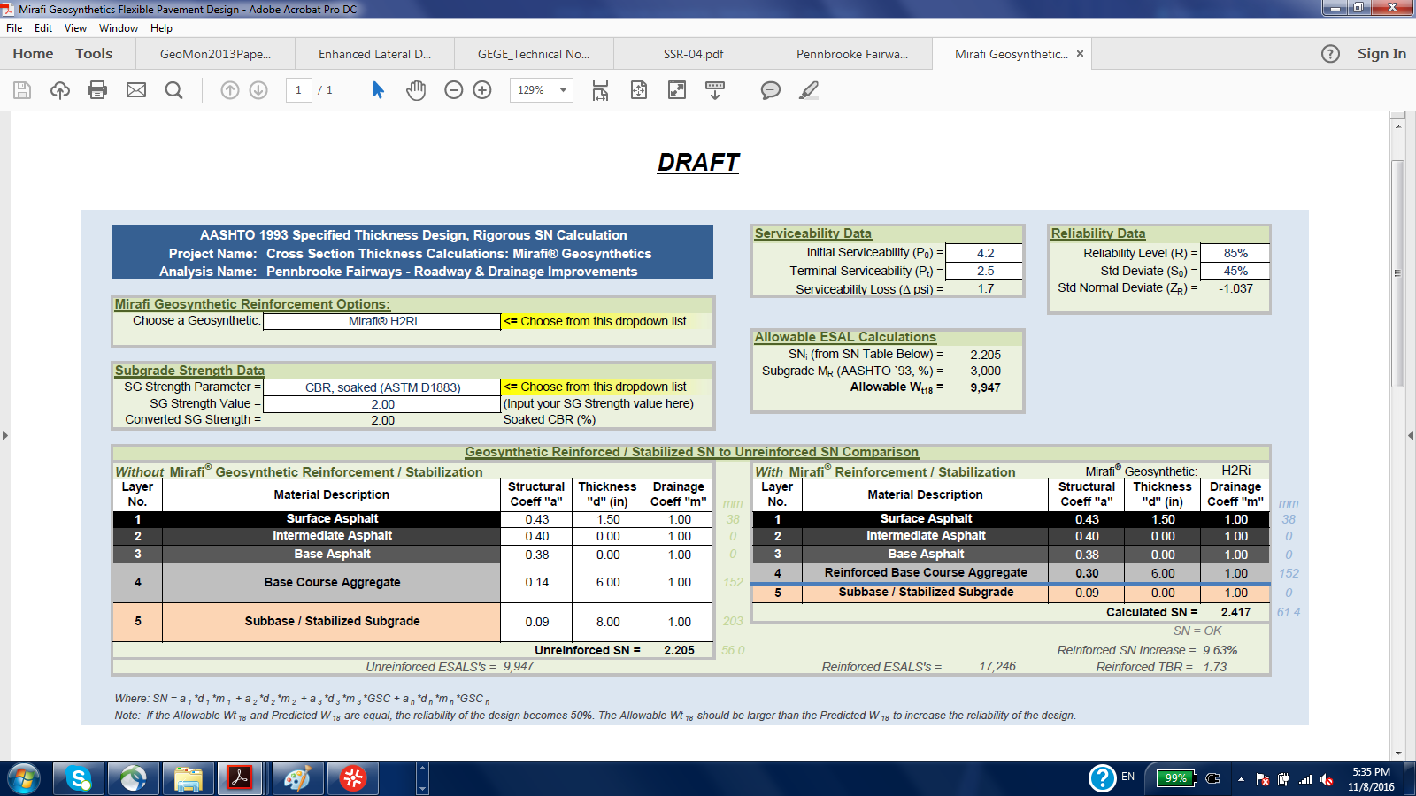

Slide 29
Pennbrooke Fairways Project
~8” of undercut with reinforcement and separation

Slide 30
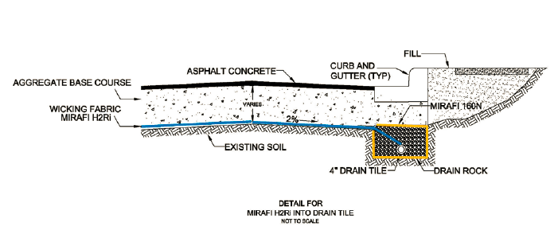
Pennbrooke Fairways Project

Slide 31
Benefits Provided
Better roadway performance – higher ESAL’s and SN
Better drainage – enhanced lateral drainage (unsaturated conditions)
Less undercut – Reinforcement
Lower execution time
Lower impact on the surroundings

Slide 32
Thank you!
QUESTIONS & COMMENTS
n.castro@tencate.com
(813) 928 9991
www.mirafi.com

